Slide 1
Inferring Gene Flow on Phylogenies
Prahlada Papper and Virginia Tartaglio
11 October 2017

Slide 2
Outline
Intro to inosculation and reticulation
Hard times inferring gene flow
ABBA-BABA: Identifying gene flow in the presence of incomplete lineage sorting
5-taxon D-statistics
HyDe and f-type phylogenetic statistics
The multispecies network coalescent
Phylogenetics in the post-”species tree” age

Slide 3
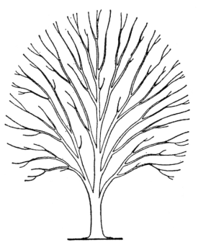

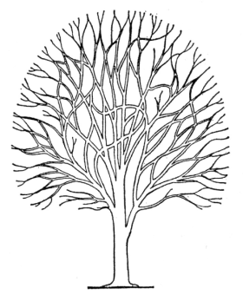
IS EVOLUTION TREELIKE?
OR IS IT NETLIKE?
YES
THE BRANCHES OF TREES UNDERGO INOSCULATION

Slide 4
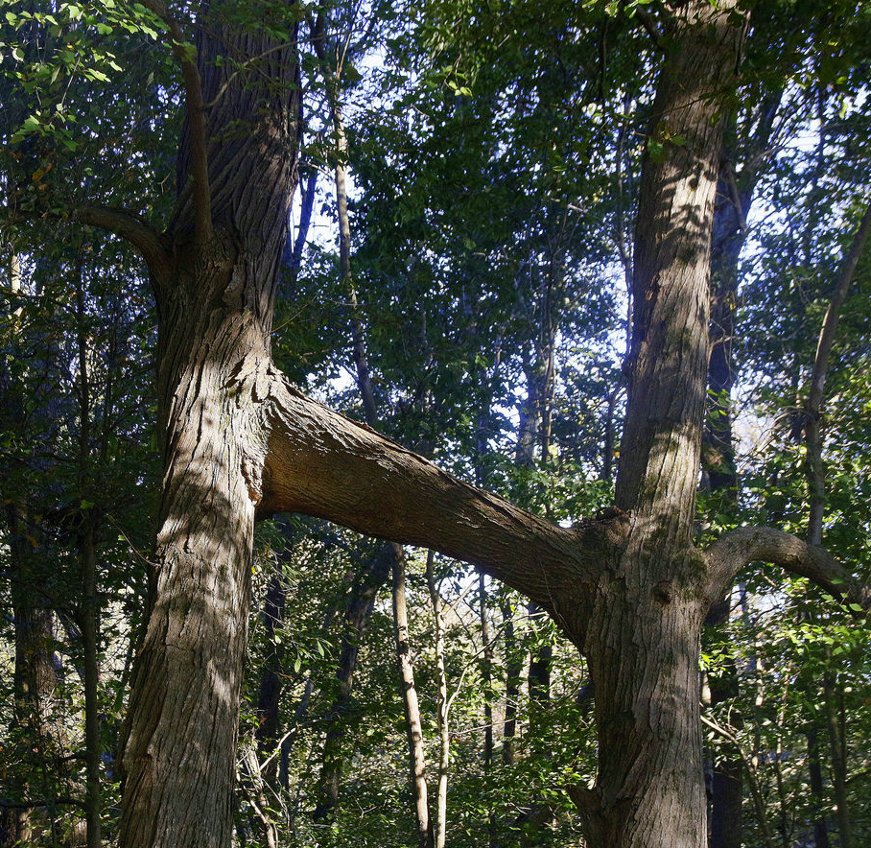
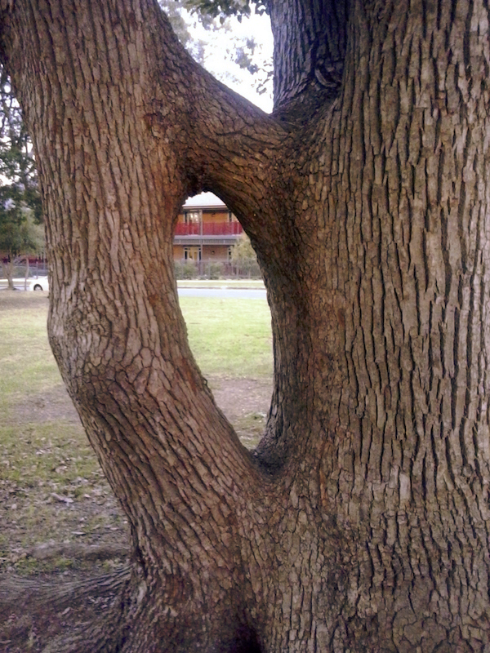
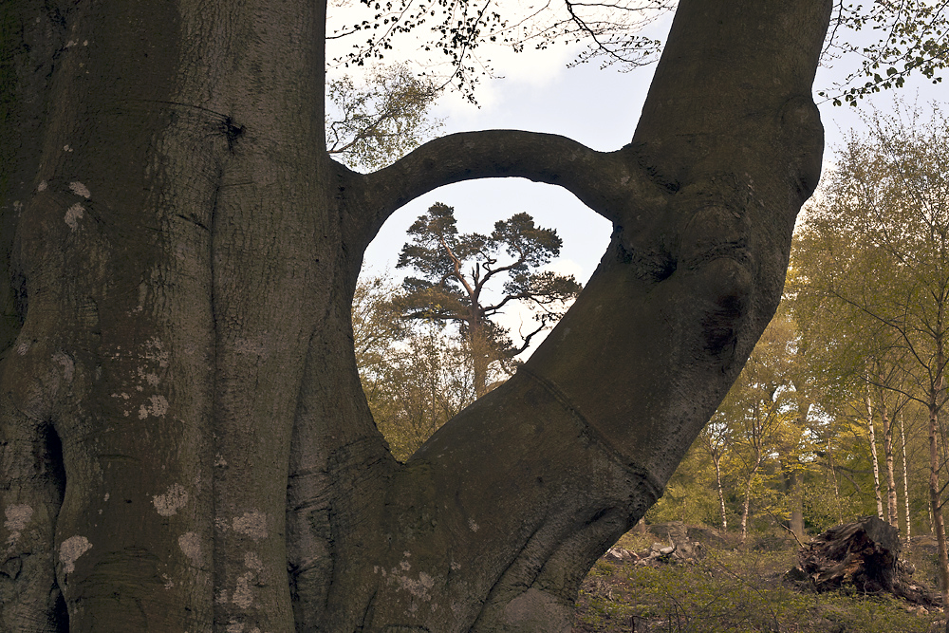

Slide 5
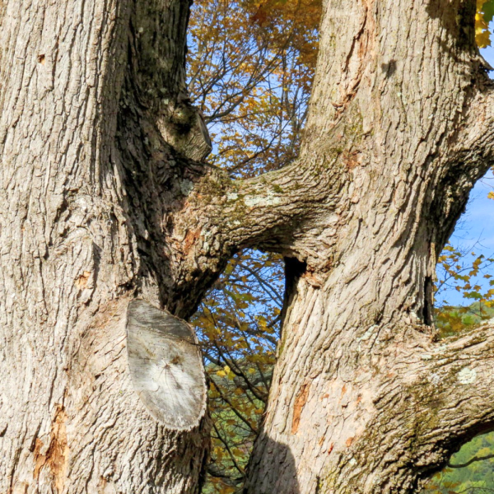
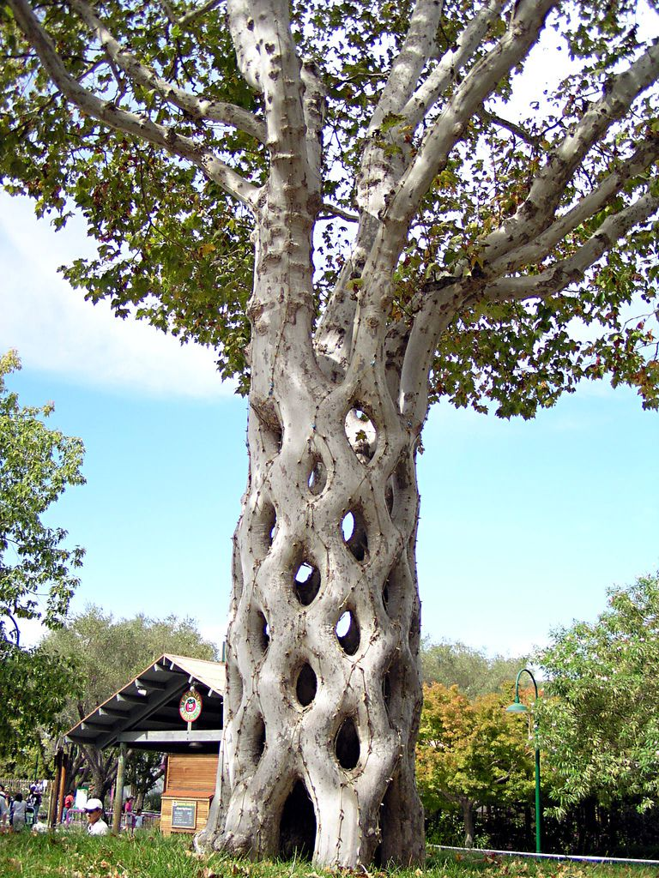
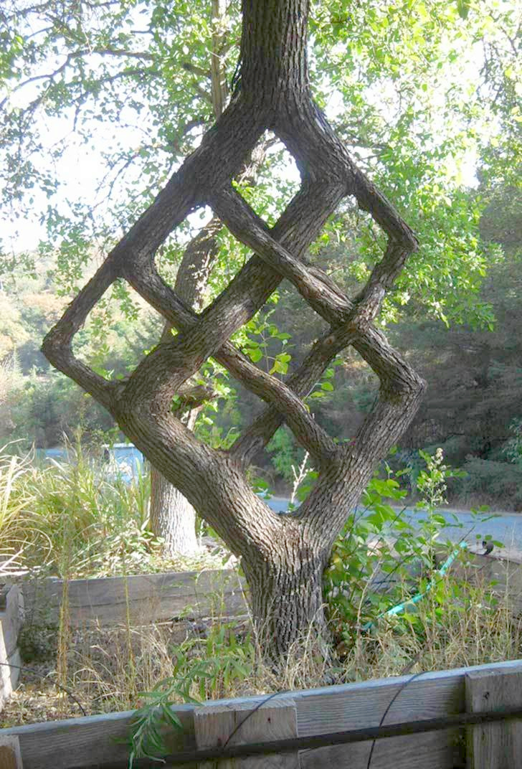

Slide 6
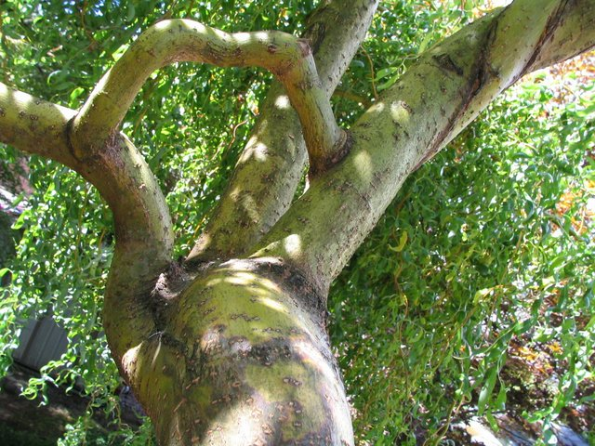
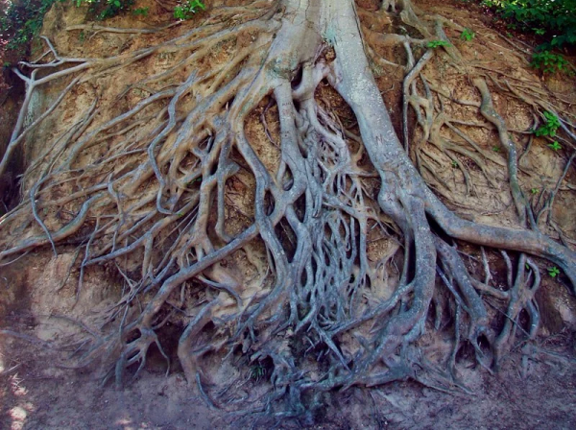
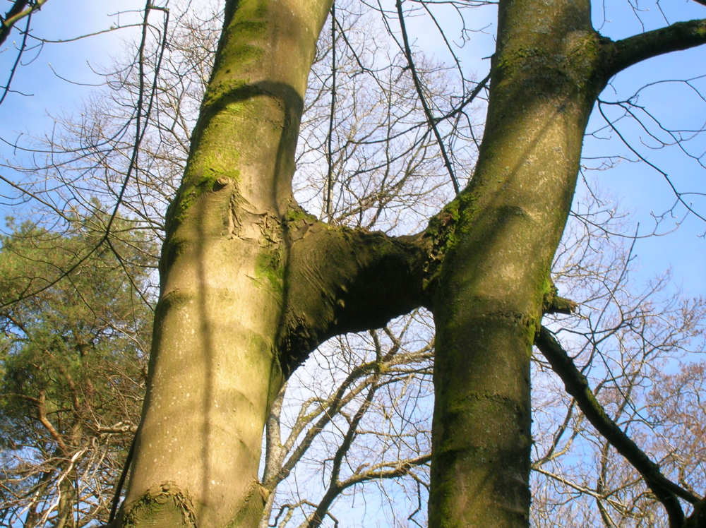
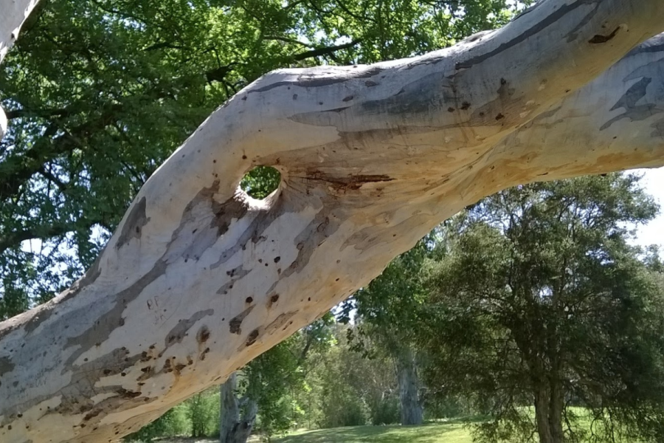
Examples of inosculation in evolutionary trees
Horizontal gene transfer
The speciation "grey-zone"
Divergence and re-contact
Reticulate rooting in the tree of life

Slide 7
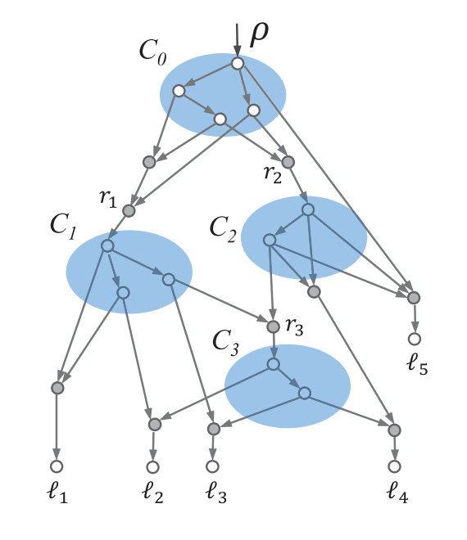
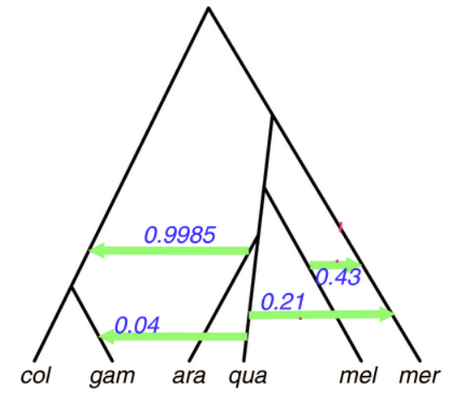
Is this all just semantics?
Reticulation?
Inosculation

Slide 8
Why care about introgression/hybridization?
For recently diverged or still-mixing species, can be critical to accurate phylogeny
Rates of introgression are key to reproductive isolation, reinforcement and speciation
At least 25% of plant species and 10% of animal species are mixing with other species (Mallet, 2005)
Philosophical implications?

Slide 9
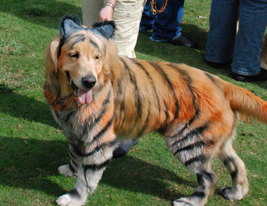
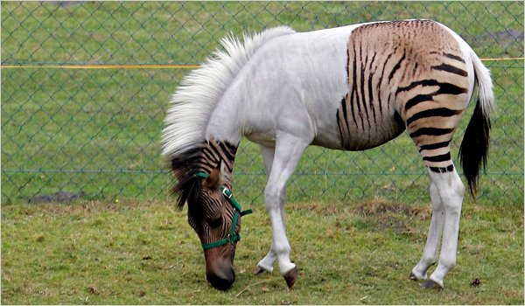
Challenges in detecting hybridization/introgression
Gene flow does not necessarily lead to permanent genetic change
Species that are very separate now may have hybridized in the past
Rates of introgression and recombination vary across the genome and among lineages
May co-occur with gene/genome duplication, selection, or ILS
http://www.personal.psu.edu/afr3/blogs/SIOW/2010/09/hybrid-animals-1.html
http://www.oregonlive.com/living/index.ssf/2012/10/halloween_parties_for_the_dogs.html

Slide 10
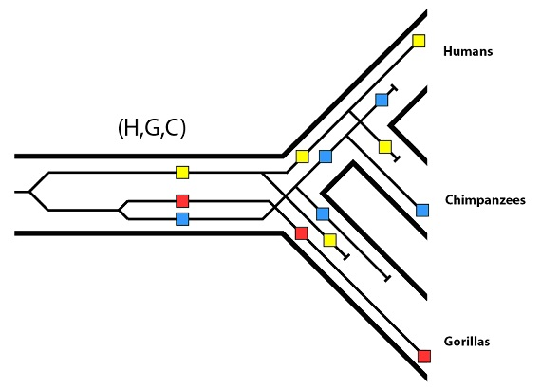
Incomplete lineage sorting
“When alleles coalesce more deeply than species divergence, as a consequence of stochastic differential assortment of ancestral polymorphism” (Sousa et al. 2017)
http://biologos.org/blogs/dennis-venema-letters-to-the-duchess/evolution-basics-species-trees-gene-trees-and-incomplete-lineage-sorting

Slide 11
Why would it be hard to distinguish between hybridization and ILS?

Slide 12
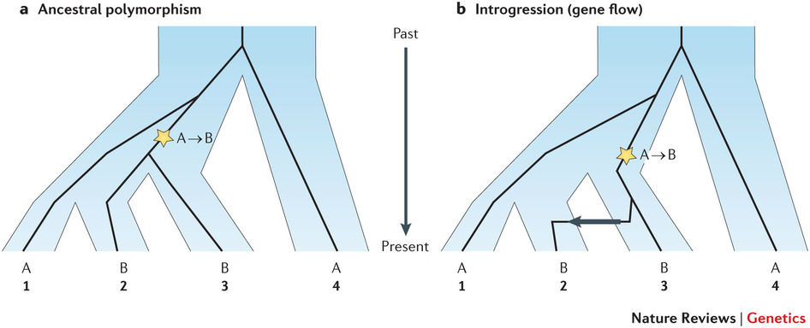
Detecting gene flow 101: The ABBA-BABA test
Sousa and Hey 2013

Slide 13
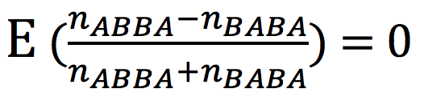
Detecting gene flow 101: The ABBA-BABA test

Slide 14
Can you foresee any potential problems with the ABBA-BABA test?

Slide 15
Issues with the ABBA-BABA test
Requires:
Having a candidate parent in advance, also doesn’t really work with multiple closely related candidate parents
Assumes:
No gene flow between your sister populations, uniform substitution rate among lineages, one allele per population, biallelic sites
Does not tell you:
Rate or direction of gene flow, extent of introgression
Implementation issues:
Martin et al. 2015 found that D-statistics are unreliable for small genomic regions, more susceptible to Ne than previously thought
Blischak et al. 2017 found D-statistic unreliable in cases of heterogenous mixing

Slide 16
Elaborations on ABBA-BABA

Slide 17
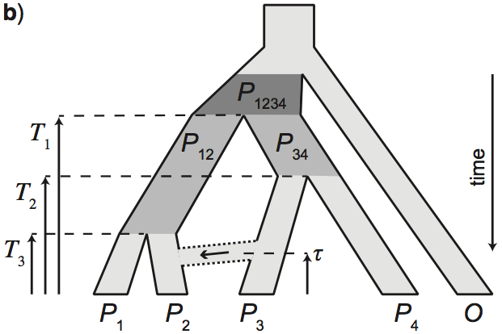
The five-taxon D-statistic

Slide 18
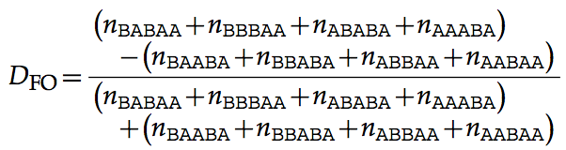
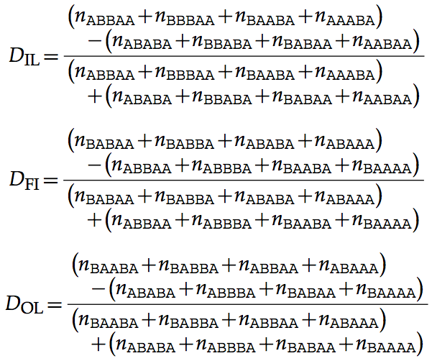
The five-taxon D-statistic

Slide 19
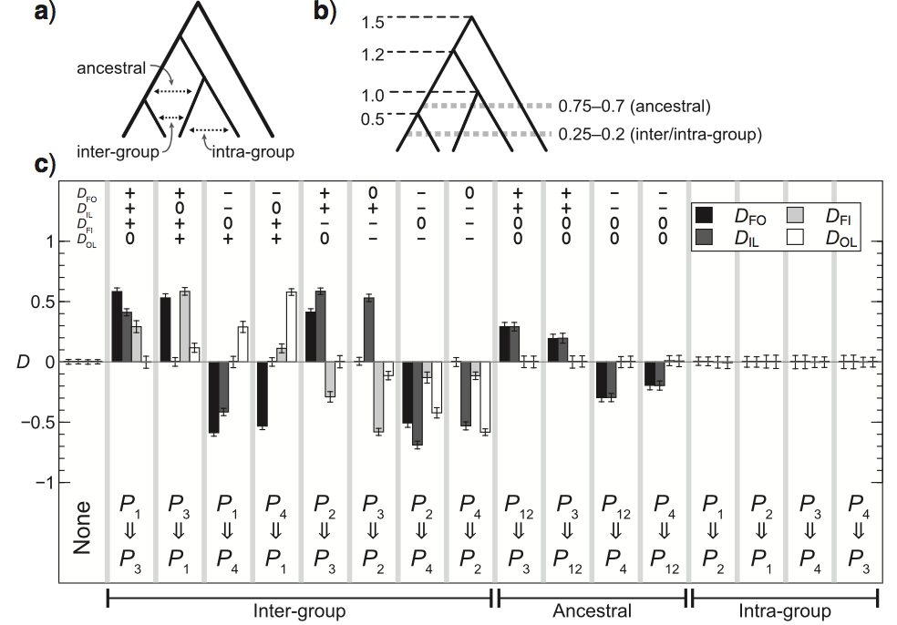
The five-taxon D-statistic

Slide 20
The five-taxon D-statistic
Allows for introgression among various combinations of taxa, including ancestral ones
Reports direction of gene flow
Doesn’t solve the problems associated with subsampling from a larger tree of close relatives
Still requires prior knowledge of population structure and assumes uniform substitution rates

Slide 21
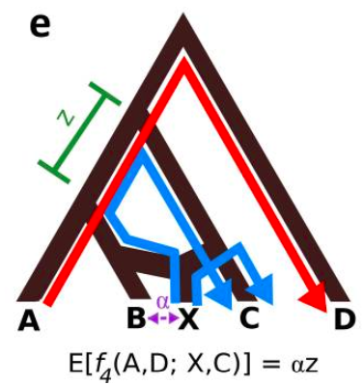
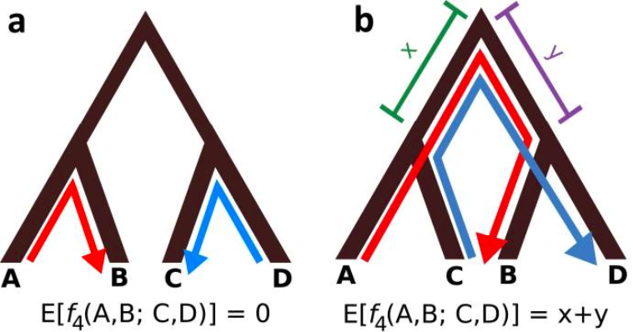
f-statistics
Like D but uses allele frequencies
Variance in allele frequencies along branches can provide evidence for mixing
Ratio between f-statistics for different populations can be used to approximate extent of gene flow

Slide 22
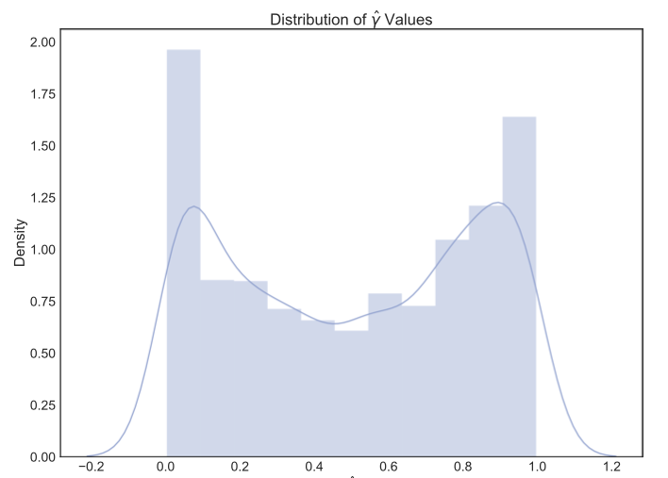
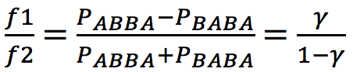
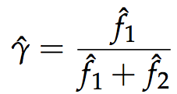
HyDe: an implementation of f-statistics
Uses the ratio of two f-statistics to derive a function that depends only on a “mixing parameter”, 𝞬, which describes extent of introgression
Yields a distribution for 𝞬 for hypothesis testing
Detects admixture at either the population or individual level

Slide 23
Broader strategies
Test whether ILS alone can explain the data (ABBA-BABA, JML)
Accommodate ILS with the multispecies coalescent (BEST, *BEAST, MP-EST, ASTRAL)
Accommodate ILS or gene flow, but without distinguishing between them (BUCKy, TreeMix)
Explicit co-inference of ILS and gene flow together (STEM-hy, PhyloNet)

Slide 24
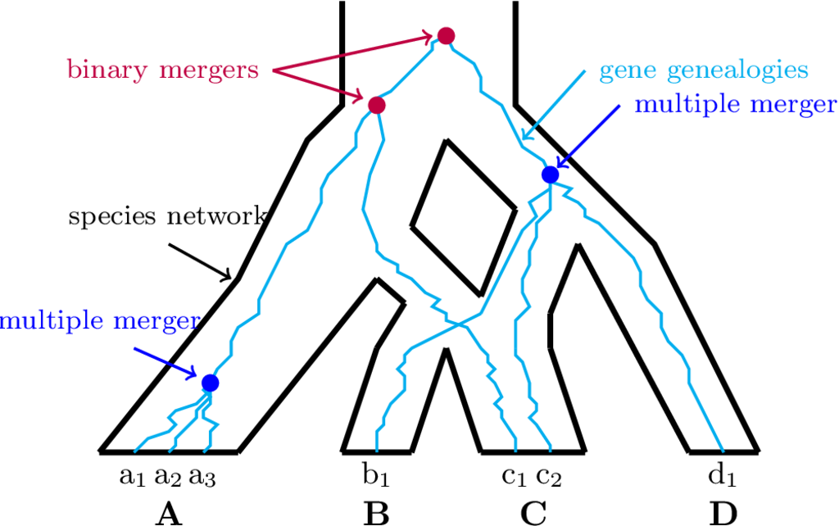
ACCOUNTING FOR ILS AND GENE FLOW WITH
THE MULTISPECIES NETWORK COALESCENT
These methods are mostly developed by Luay Nakhleh's group at Rice University, see Yu et al. 2012, Yu and Nakhleh 2015, Wen et al. 2016, Wen and Nakhleh 2017, but also Solís-Lemus and Ané 2016
figure Joe Zhu 2017, Hybrid-Lambda package

Slide 25
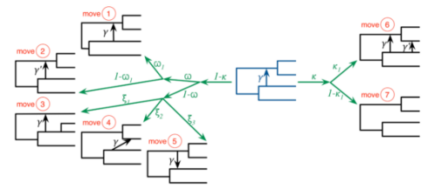

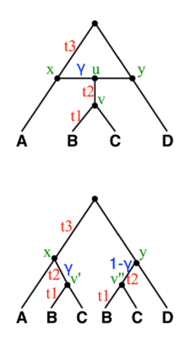
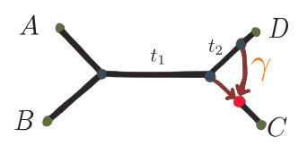
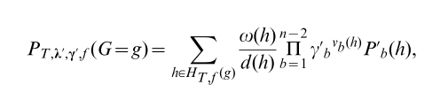
WHAT YOU NEED IN ORDER TO IMPLEMENT
THE MULTISPECIES NETWORK COALESCENT
a proposal mechanism
for new networks in a ML or Bayesian MCMC search
OR
a pseudolikehood method
that can be searched exhaustively (e.g. quartets or rooted triplets)
a likelihood function
to calculate the probability of the gene trees given a species network
a set of gene trees
with posterior probabilities
or as BUCKy concordance

Slide 26
SOFTWARE IMPLEMENTATIONS OF
THE MULTISPECIES NETWORK COALESCENT
 | Maximum Likelihood | Bayesian | Maximum Pseudolikehood
PhyloNet | X (from gene trees) | X (from gene trees) | X (rooted triplets)
BEAST 2 w/ SpeciesNetwork |  | X (joint estimation of gene trees)
PhyloNetworks |  |  | X (quartets)

Slide 27
SOME NASTY ISSUES WITH
THE MULTISPECIES NETWORK COALESCENT
1) Computation Time
Inference time balloons rapidly under ML or Bayesian MCMC with either > ~10 taxa or > ~50 loci
Maximum pseudolikelihood methods can handle genomic scale data, but still balloons with more than 20-30 taxa
2) Distinguishability
Several classes of reticulation have been shown to be unresolvable, i.e. many species networks compatible with the gene trees
Canonical networks are the total set of identifiable species networks

Slide 28
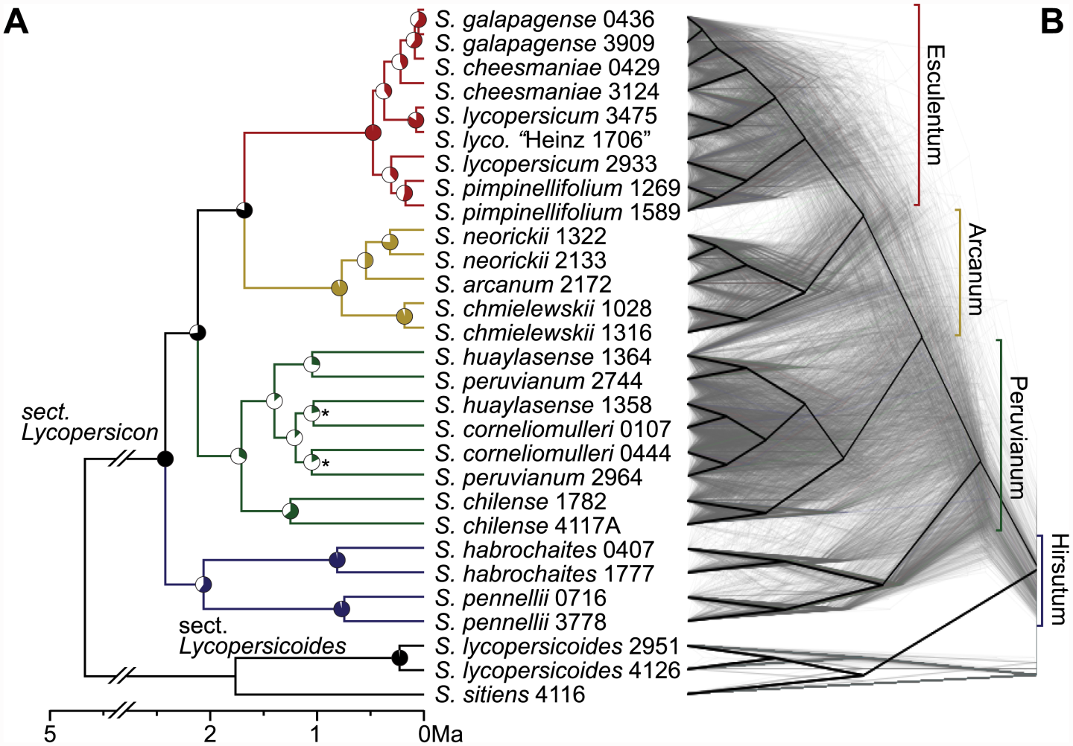
Pease et al. 2016, PLoS Biology

Slide 29
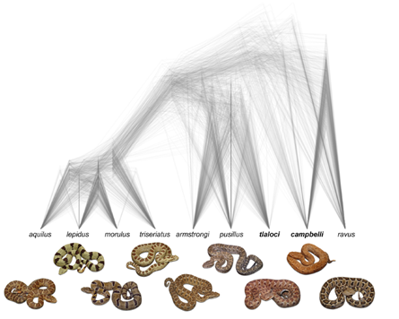
CAN WE IMAGINE PHYLOGENETICS WITHOUT A "SPECIES TREE" AT ALL?
Visualization of the "cloudogram" of gene trees or contigs, e.g. with DiversiTree (as used with posterior trees or bootstraps)
Direct analysis of the tree set to characterize ILS, gene flow, and other forms of inheritance
Reduced dimensionality analyses (e.g. MDS, NLDS, PCoA) to identify major and minor clusters of inheritance, e.g. methods in TreeScaper or the treespace package in R
figure from Bryson et al. 2014, Zootaxa

